Slide 1

Developing an Operating System from Scratch for Educational Purposes
By Mustafa Sibai

Slide 2
Introduction
Creating an operating system from scratch is a complex and challenging undertaking, but it offers invaluable insights into the core principles of computer systems and software development. This research proposal outlines a self-directed learning project to develop a basic operating system and create a tutorial series to be uploaded on YouTube.

Slide 3
Research Problem
Software today is
Slow
Bloated
Inefficient
full of bugs
This can be attributed to many reasons one of which is the programmers lack of deep understanding on how computers work.

Slide 4
Why software is slow today?
Programmers lack of deep understanding of computer hardware
Fast software is dependent on the programmer understanding of the hardware
Lack of understanding of the hardware can be attributed to
Programmers not interested in hardware
Lack of time and energy
Lack of learning resources
Too busy in their daily job
Lazy
Computers are billions of times faster than 1970 computers yet we have similar software in terms of speed or in some cases wrose.

Slide 5
Why create an OS?
Creating an OS will give deep insight on how the hardware works and how a typical OS work behind the scenes.
It will give a deep insight into how an OS manages memory. How an OS schedules applications and processes and how drives are written.
When creating an OS, programmers are programming on bare bone metal. They have nothing between them and the hardware. So in order to create an OS. They must understand the hardware on a deep level which is the end goal.

Slide 6
Research Question
What are the fundamental building blocks for developing an operating system from scratch, and how can it be explained effectively to beginners?
What programming language and tools are most suitable for constructing an operating system?
How can the video series can be organized to facilitate a gradual and interactive learning experience suitable for individuals with different levels of experience?
What are the main obstacles a student could face while developing an operating system?
How can the video educational content be optimized for clarity and active participation to enhance the learning experience for a diverse audience?
What are the root causes of inefficiency within operating systems?
How can the knowledge and skills gained through operating system development be utilized beyond this project?

Slide 7
Aims and Objectives
Aims
Develop a Functional Operating System
Facilitate Progressive Learning
Promote Self-Directed Learning
Foster a Supportive Learning Community
Share Knowledge and Experience
Objectives
Develop a Bootloader and Kernel
Learn C language and X86 Assembly
Structure Educational Content
Collect Viewer Feedback

Slide 8
Literature Review
Many resources exist on how to create an OS from scratch, however a lot of them skip essential knowledge that programmers need before making an OS.

Slide 9
Methodology
Research Method:
Conducted a systematic search of academic databases( Google Scholar, Research Gate, LeanPub).
Utilized specific keywords to pinpoint relevant literature on OS development.
Selection Criteria:
Incorporated scholarly articles and books that have been published in the last decade.
Screened publications based on the relevance and excluding advanced or specialized OS topics.
Review Process:
Critically evaluated selected works on fundamentals OS components and user-friendly educational approaches.
Synthesis & Analysis:
Identified key elements and recurring patterns in the literature to establish a comprehensive grasp of OS development basics.

Slide 10
Ethical Considerations
Transparency and Honesty: Be transparent and honest on what this YouTube series is about and for. Avoid presenting myself as an expert.
Intellectual Property: Mention the use of any external copyrighted materials such as code or resources and give proper credit.
Safety and Security: Emphasize responsible and ethical practices in OS development. Discourage hacking, and malicious activities.
Attribution and Citations: Provide proper citations for any external resources.
Ethical Responsibility: Recognize my responsibility as an educator and content creator. I should be respectful in my videos and be conscious of my viewers time.

Slide 11
Artefact Description
Video Lecture Series:
Enhances learning through the use of visual aids and real-life Illustrations.
Coding Demonstrations:
Assists learners in applying OS functionalities with C and assembly language.
Promotes practical understanding of theoretical concepts.
Comprehensive Written Guides:
Offers in-depth explanations, troubleshooting tips and code samples.
Serves as a valuable reference throughout different stages of OS development.

Slide 12
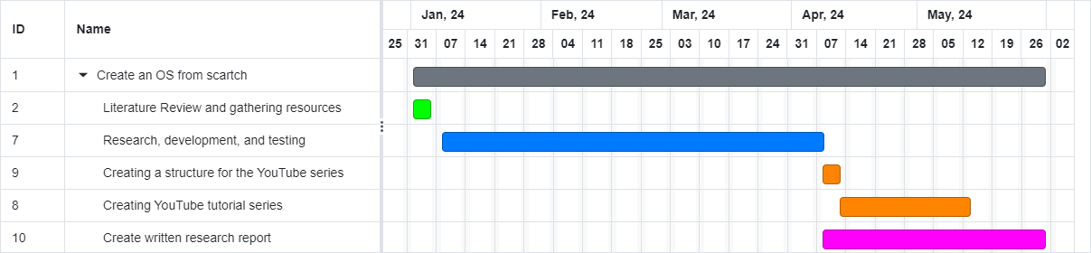
Timeline

Slide 13
References
Alqarni, Shahad & El-Sharawy, Enas & Saeed, Eman & Khamis, Fatimah & Alqahtani, Lama. (2023). Operating System Architecture.
Renê S. Pinto, Pedro Nobile, Edwin Mamani, Lourenço P. Júnior, Helder J.F. Luz, Francisco J. Monaco, Operating System from the Scratch: A Problem-based Learning Approach for the Emerging Demands on OS Development, Procedia Computer Science, Volume 18, 2013, Pages 2472-2481,ISSN 1877-0509,
Michael D. Black. 2009. Build an operating system from scratch: a project for an introductory operating systems course. In Proceedings of the 40th ACM technical symposium on Computer science education (SIGCSE '09). Association for Computing Machinery, New York, NY, USA, 448–452.
Agal, Sanjay. (2023). FUNDAMENTALS OF OPERATING SYSTEMS. 10.5281/zenodo.8420194.
Hilal, Noor & Ali, Zainab & Dhafer, Rawan & El-Sharawy, Enas & Aldoosary, Badriah. (2023). Operating System.
CodePulse. (2020). Write Your Own 64-bit Operating System Kernel #1 - Boot code and multiboot header. [Online Video]. 20 September 2020. Available from: https://www.youtube.com/watch?v=FkrpUaGThTQ. [Accessed: 10 October 2023].
nanobyte. (2019). Building an OS - 1 - Hello world. [Online Video]. 27 January 2019. Available from: https://www.youtube.com/watch?v=9t-SPC7Tczc. [Accessed: 10 October 2023].
Chris Titus Tech. (2021). Build Your Own Operating System. [Online Video]. 29 January 2021. Available from: https://www.youtube.com/watch?v=YbXHU7W7Its. [Accessed: 10 October 2023].
Daedalus Community. (2020). Making an OS (x86) Chapter 1 - CPU, Assembly, Booting. [Online Video]. 23 August 2020. Available from: https://www.youtube.com/watch?v=MwPjvJ9ulSc. [Accessed: 10 October 2023].
Coding With Ashutosh. (2022). OS in Scratch 3.0 || Operating System Part - 1. [Online Video]. 20 March 2022. Available from: https://www.youtube.com/watch?v=ucMV68Gv9WQ. [Accessed: 10 October 2023].
Blundell, N., 2023. OS Dev. Writing a Simple Operating System — from Scratch, [Online]. December 2, 2010, 77. Available at: https://www.cs.bham.ac.uk/~exr/lectures/opsys/10_11/lectures/os-dev.pdf [Accessed 10 October 2023].
Pesse, S. (2014). How to Make a Computer Operating System from Scratch using C/C++. Retrieved from https://github.com/SamyPesse/how-to-create-an-operating-system

